Slide 1
Building a Data Lake with Egeria
Mandy Chessell
ODPi Egeria Project Lead
IBM Distinguished Engineer

Slide 2
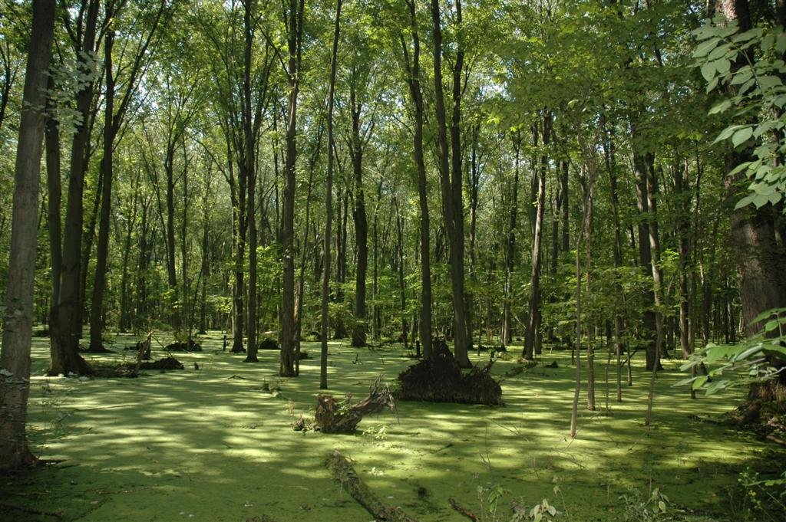

Big Data Lakes or Swamps?
As we bring data together, are we creating a data swamp?
  No one is sure of the origin or purity of data.
  No one can find the data they need.
  No one knows what data is present and and if it is being adequately protected.
How do we build trust in big data?
  Need trust both to share and to consume data.
  Need understanding of quality, origin and ownership of data.
  Need classification of data to govern and protect it.
  Need timely, reliable data feeds and results.
  All built on secure and reliable infrastructure.

Slide 3
Data lake anti-patterns
The rivals
  Bake-off between data warehouse team and Hadoop team
The replica
  Reimplementation of data warehouse design on Hadoop
The roach motel
  Data is loaded but nothing comes out
The swamp
  Data dumping ground – no-one can find anything so get own copy
The artisans
  Hand-written code for data lake provisioning

Slide 4
Architecture necessary for business agility and cost reduction
Where do costs escalate?
  Unnecessary duplication of function across silos
  Pushing new features into a platform that are in appropriate
  Lack of control of the whole lifecycle of data
    Investing in transforming and fixing data of low value
    When do you archive? when do you delete?
  Deploying a new technology in isolation
    It needs connecting up sooner or later, and in the meantime there is a lot of duplication

Slide 5
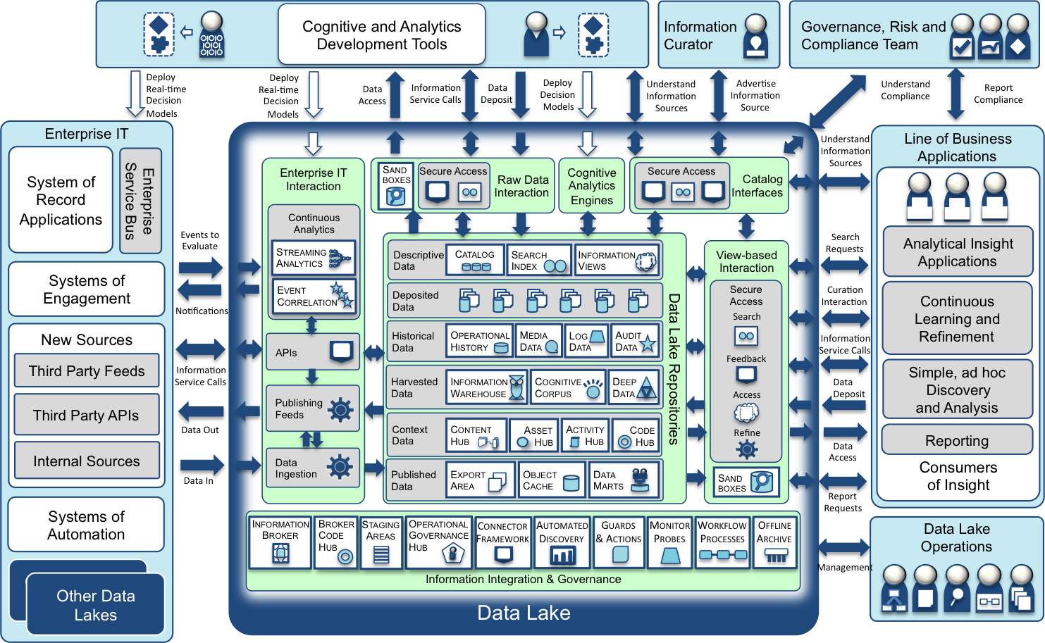
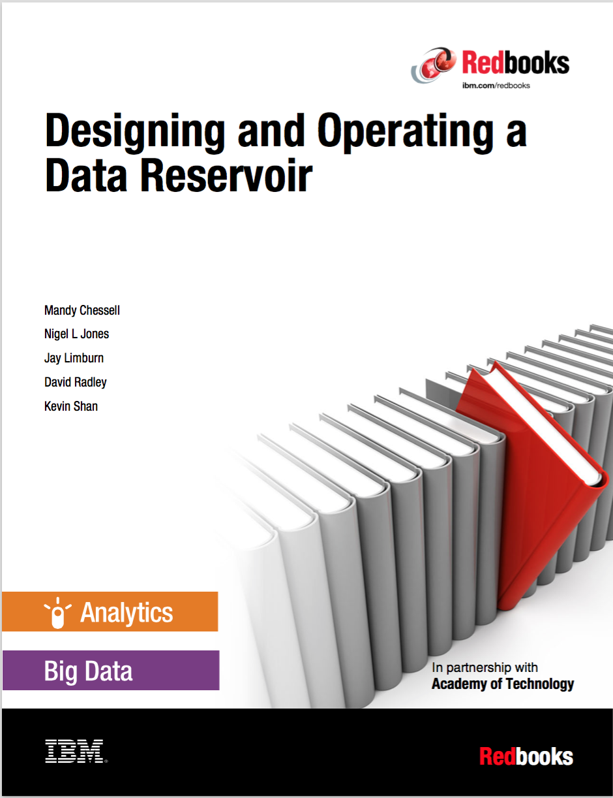
Data Lake – expanding the scope of data processed
  http://www.redbooks.ibm.com/Redbooks.nsf/RedpieceAbstracts/sg248274.html?Open

Slide 6
The subsystems inside IBM’s Data Lake
Rapid analytics development
Describe Data
Build Trust
Analytics
Teams
Information
Curator
Governance, Risk and
Compliance Team
Data Lake (System of Insight)
Information Management and Governance Fabric
Enterprise IT
Enterprise
IT Data
Exchange
Self-Service
Access
Analytics
Engines
Catalogue
Systems of Record
Self-service experiments and analysis
Data Lake Repositories
Self-Service
Access
Systems of Engagement
Line of Business
Teams
New Sources
Analytics execution
Systems of Automation
Analytics execution
Other Data Lakes
Data Lake
Operations

Slide 7
Data lakes v data warehouses – what has changed?
The data lakes are a hub
  Receiving information about the current state of the business
  Supplying insight to drive the business
  Supporting the development of real-time analytics
Warehouse is a flow left to right
  Adjusting the truth from the “operational systems”
  Creating views of the past for downstream consumption
Note the data warehouse remains vital for regulatory and other types of reporting and lives inside the data lake

Slide 8
Data lake as a hub
Core Business Systems
Big data and warehouse environment
Exchange of data and insight
Enterprise IT
Systems of Record
Requests for action and push of status information
Data Lake
Self-service for
ad hoc analytics
Systems of Engagement
Exploration
Deployment
Discovery
Digital Channels
Agile analytics development
New Sources
Locate Data
Build Analytic Models
Systems of Automation
Analytics deployed
providing deep
Understanding
of customer
Run Analytic Models
Other Data Lakes

Slide 9
How does the data lake support analytics development?
1
2
Advertise
Catalog
Data Lake

Slide 10
How does the data lake support analytics development?
3
Discover
1
2
Advertise
Catalog
Data Lake
4
Provision

Slide 11
How does the data lake support analytics development?
3
5
Discover
Explore
1
2
Advertise
Catalog
Data Lake
Sandbox
4
Provision

Slide 12
How does the data lake support analytics development?
3
5
6
Discover
Explore
Deploy
1
2
Advertise
Catalog
Data Lake
Sandbox
4
Provision

Slide 13
How does the data lake support data distribution?
3
Access
Catalog
Data Lake
1
Provision
2
Distribute

Slide 14
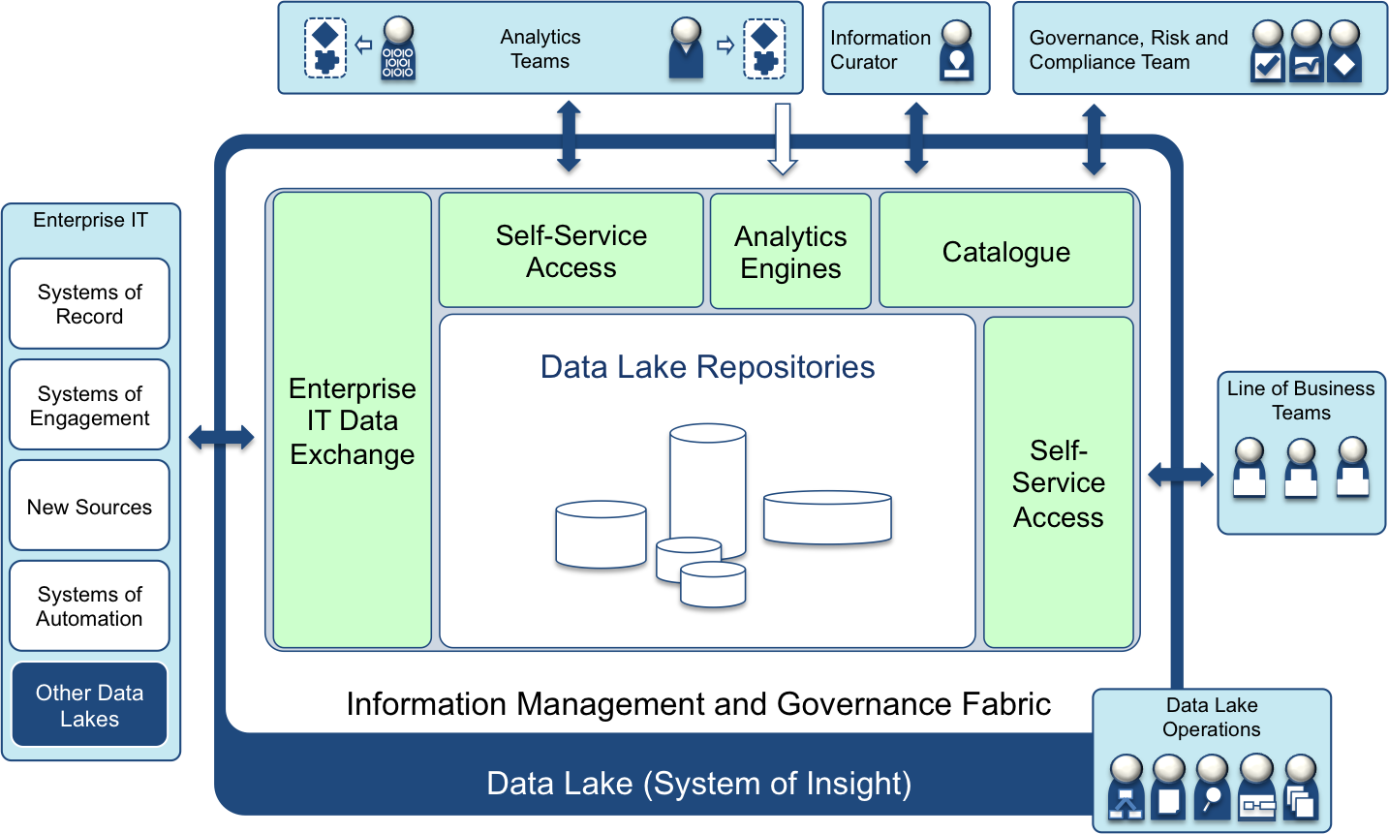
Considerations for a well-managed and governed data lake
5
Curation of all data to define meaning and classifications
6
9
Business-led information governance and management
Access to raw data to develop new production analytics.
4
2
Effective interchange of data and insight with other systems.
Catalog of data, ownership, meaning and permitted usage
https://www.ibmbigdatahub.com/blog/building-data-reservoir-use-big-data-confidence
10
Moderated, view-based self-service access to data and analytics for line of business.
No direct access to repositories
3
7
1
Multiple repositories organized based on source and usage; hosted on appropriate data platforms for workload.
Data-centric Security
Active monitoring and management of data
8
Notes:
https://www.ibmbigdatahub.com/blog/building-data-reservoir-use-big-data-confidence

Slide 15
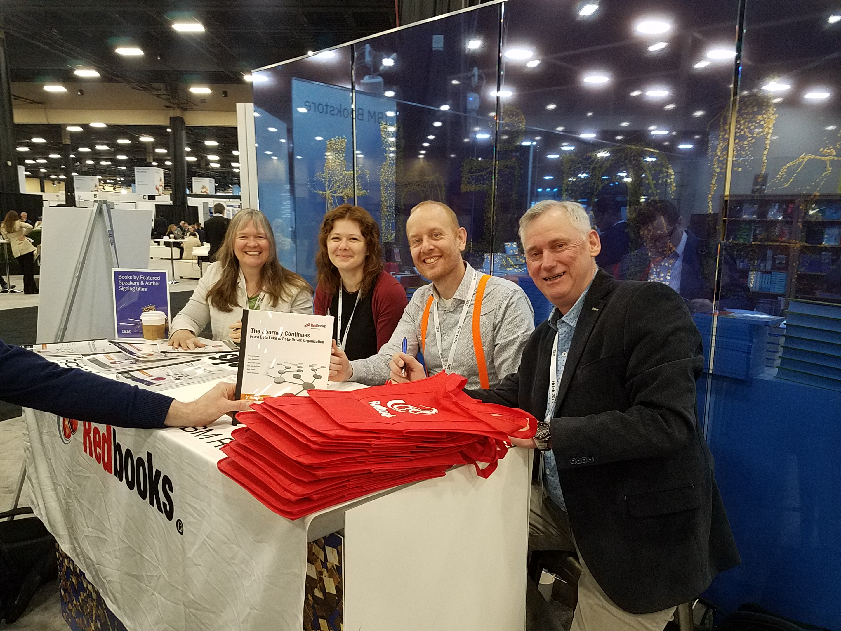
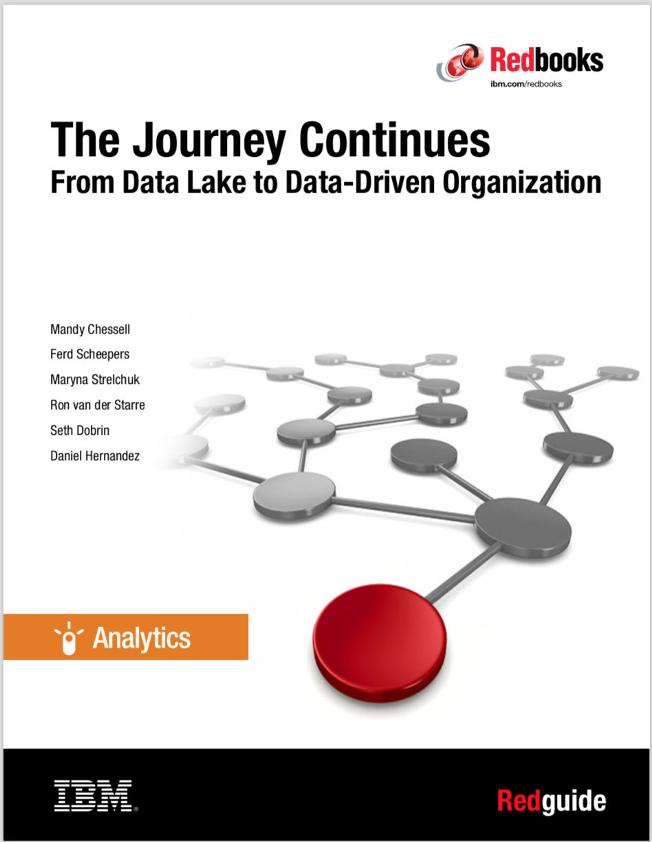
The Journey Continues …
http://www.redbooks.ibm.com/abstracts/redp5486.html?Open
https://www.youtube.com/watch?v=LMmm74t-BBA

Slide 16
Data Lake use cases with ODPi Egeria
How it works

Slide 17
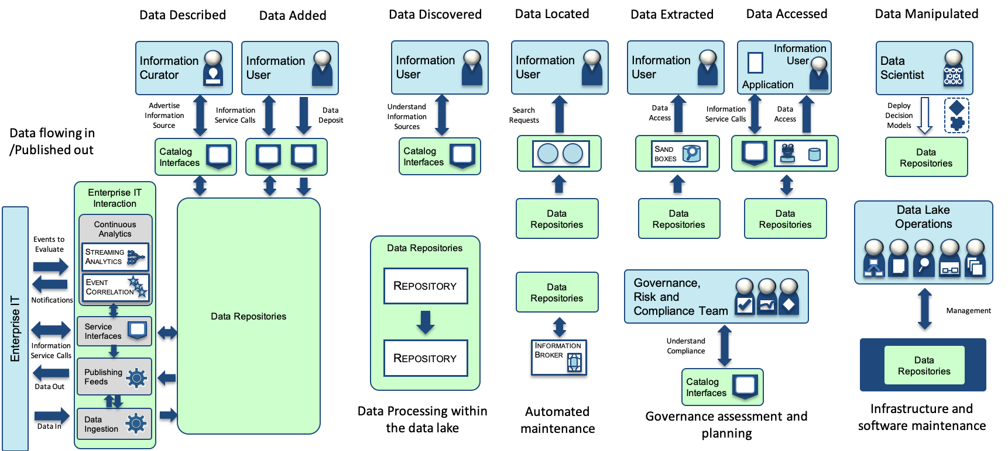
Key Data Interactions

Slide 18
Key Data Interactions

Slide 19
Key Data Interactions

Slide 20
Key Data Interactions

Slide 21
Key Data Interactions

Slide 22
Key Data Interactions

Slide 23
Key Data Interactions

Slide 24
Key Data Interactions

Slide 25
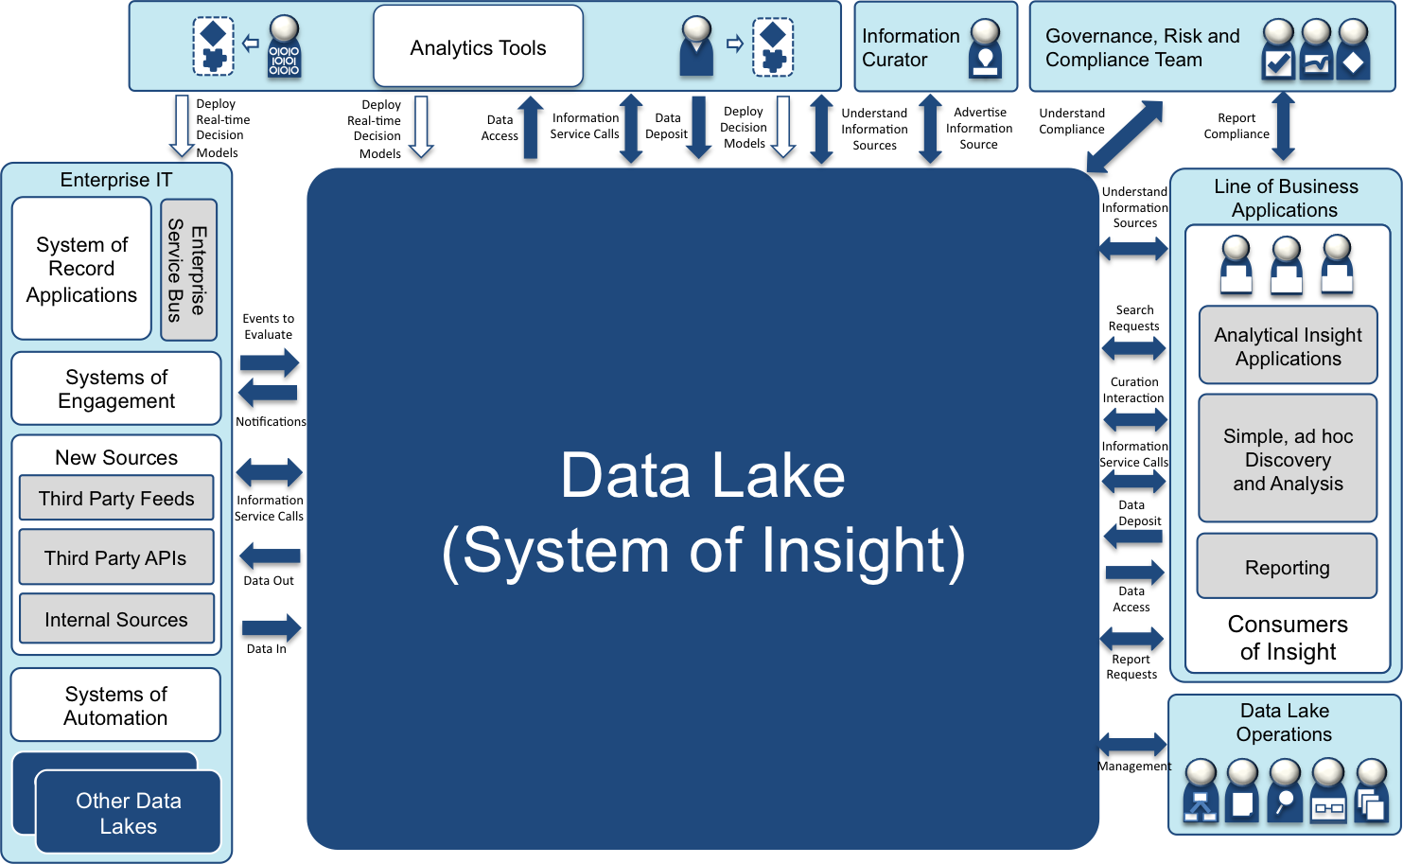
System context diagram
Shows all interactions with external components

Slide 26
System context diagram
Provided by Egeria
Uses open metadata

Slide 27
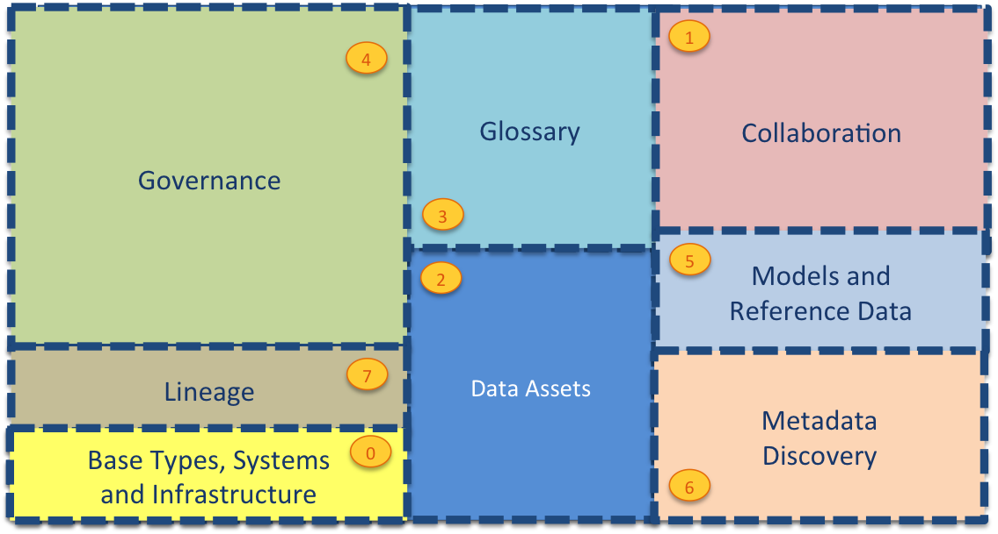
Current Open Metadata Access Services (OMASs)
Digital Service
Asset Owner
Asset Lineage
Subject Area
Asset Catalog
Asset Consumer
Stewardship Action
Community Profile
Information View
Project Management
Data Science
Governance Program
Software Developer
Data Privacy
Digital Architecture
Data Engine
DevOps
Security Officer
Design Model
Governance Engine
IT Infrastructure
Data Manager
Discovery Engine
Analytics Modeling

Slide 28




Event-driven governance
Assign
Owner
New
Database
Open
Metadata
Classify
Data
Use
Data

Slide 29
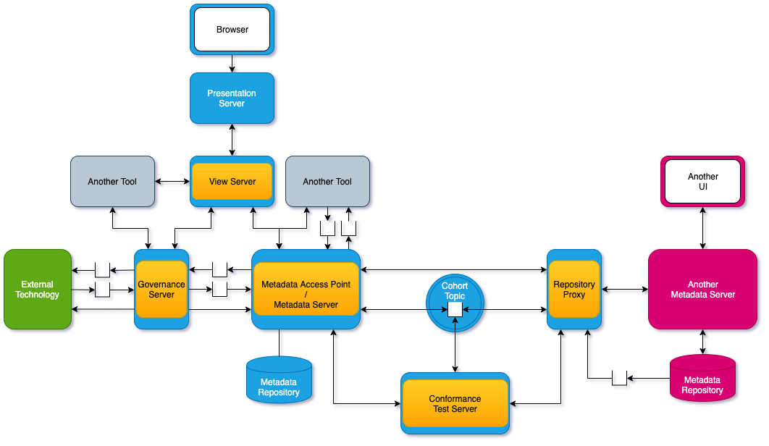
Connected OMAG Servers

Slide 30
Key Data Interactions

Slide 31
Data onboarding
Curation
Metadata
Server
Asset Owner OMAS
New assets
New content for existing assets
Integration
Daemon
Data Manager OMAS
Integration
Daemon
Data Engine OMAS
Discovery
Server
Discovery Engine OMAS

Slide 32
Key Data Interactions

Slide 33
Ad hoc data search and use
Understand Assets
Sandbox
The following OMASs support retrieving metadata:
  Asset Catalog
  Asset Consumer
The Stewardship Server supports the triggering of sandbox provisioning requests
The Security Sync Server supports configuring security in access points
Provision
(calls Data Engine OMAS)
Metadata
Server
Asset Catalog OMAS
Stewardship
Server
Asset Consumer OMAS
Stewardship Action OMAS
Security Sync Server
Governance Engine OMAS
Configure Security
Search Service

Slide 34
Reporting and analytics applications
Applications can use:
  Asset Catalog and Asset Consumer OMASs
  OCF Connectors
  Specialist OMAS
    Analytics Modeling OMAS

Slide 35
Key Data Interactions

Slide 36
Analytics Lifecycle
Data Science OMAS
Manages analytical models
Exploration
Deployment
Discovery
DevOps OMAS
Manages deployment
Locate Data
Build Analytic Models
Run Analytic Models

Slide 37
Key Data Interactions

Slide 38
Repositories
Data Lake Repositories
Descriptive
Data
Catalog
Search
Index
Information
Views
Data Engine OMAS records data movement
Data provisioning engine may call OMAS directly, or an integration daemon may capture lineage.
Deposited
Data
Historical
Data
Operational
History
Log
Data
Audit
Data
Harvested
Data
Information
Warehouse
Deep Data
Context
Data
Content
Hub
Asset
Hub
Activity
Hub
Code
Hub
Published
Data
Export
Area
Object
Cache
Data
Marts

Slide 39
Key Data Interactions

Slide 40
Archiving and related maintenance
Assets can be added/removed from Governance Zones.
Governance Program OMAS
  Sets up zone definitions and related policies
  Provides APIs to governance processes to operate on assets in zones

Slide 41
Key Data Interactions

Slide 42
Interfaces for the governance teams
Governance Program OMAS supports the lifecycle of the organization’s governance programs
  Understanding the business drivers that provide requirements and direction to the governance program.
  Laying down the governance policies (principles, obligations and approaches) that frame the governance program.
  Planning and defining the governance controls that detail how these governance policies will be implemented in the organization and enumerating the implications of these decisions and the expected outcomes.
  Defining the organization's roles and responsibilities that will support the program.
  Commissioning campaigns and projects to implement the governance controls and the collection of measurements to assess the success of the program.
  Reviewing the impact of the governance program and adjusting as needed.
  --> additional campaigns or projects
  --> adjusting the policies and controls
  Reviewing the strategy, business and regulatory landscape.
  --> adjusting the business drivers
Security Officer OMAS provides specialist APIs and events for managing the security requirements.

Slide 43
Key Data Interactions

Slide 44
Deploying new function in data lake
IT Infrastructure defines the infrastructure of the data lake
DevOps OMAS updates certificates and the metadata about the components deployed on the infrastructure

Slide 45






























Layers
Data
Reservoir
Services
Catalog
Interfaces
Deploy
Decision
Models
Raw Data
Interaction
View-based
Interaction
Development
Services
Data Lake
Operations
Integration
Processes,
Rules & APIs
Operational
Governance
Services
Monitors
and Guards
Business
Processes
Decision
Models
Integration and
Governance Engine
Monitoring
Workflow
Engine
Analytics
Engines
Databases
MDM
Hub
Hadoop
Infrastructure
Management
Services
Infrastructure
Operators

Slide 46
Summary

Slide 47
Open forum
z
z
z
z
z
z
z
Questions?

Slide 48
Further Data Lake pictures
For interest …

Slide 49
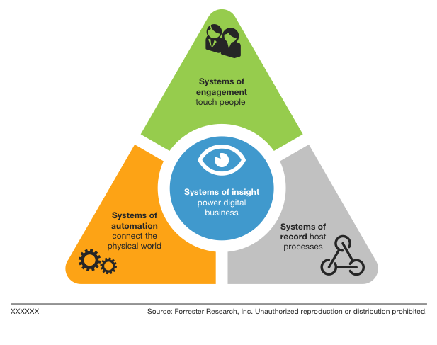
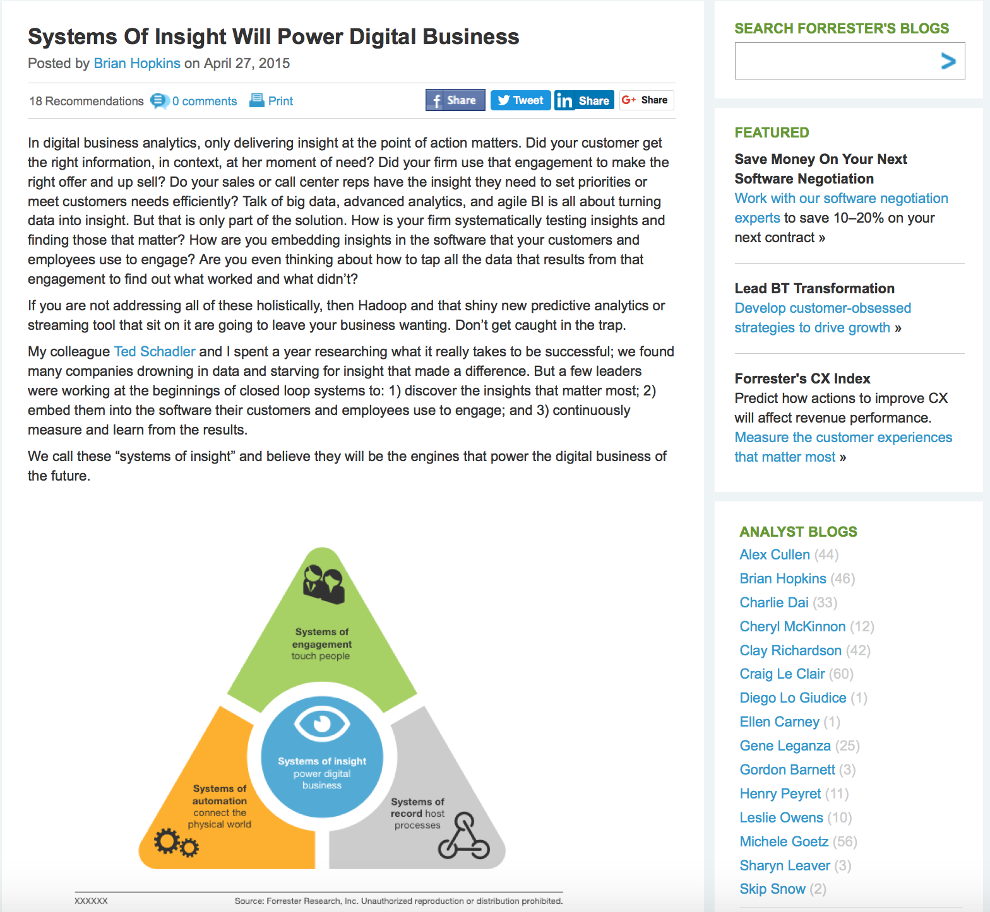
Forrester – The system of insight will power digital business
… a few leaders were working at the beginnings of closed loop systems to: 1) discover the insights that matter most; 2) embed them into the software their customers and employees use to engage; and 3) continuously measure and learn from the results.
We call these “systems of insight” and believe they will be the engines that power the digital business of the future.
http://blogs.forrester.com/brian_hopkins/15-04-27-systems_of_insight_will_power_digital_business

Slide 50
The Data Lake
Data Lake
Information Management and Governance Fabric
Data Lake Services
Data Lake Repositories
Data Lake = Efficient Management, Governance, Protection and Access.

Slide 51
Users supported by IBM’s Data Lake
Analytics
Teams
Information
Curator
Governance, Risk and
Compliance Team
Data Lake (System of Insight)
Information Management and Governance Fabric
Enterprise IT
Data Lake Services
Systems of Record
Data Lake Repositories
Systems of Engagement
Line of Business
Teams
New Sources
Systems of Automation
Other Data Lakes
Data Lake
Operations

Slide 52
The subsystems inside IBM’s Data Lake
Analytics
Teams
Information
Curator
Governance, Risk and
Compliance Team
Data Lake (System of Insight)
Information Management and Governance Fabric
Enterprise IT
Enterprise
IT Data
Exchange
Self-Service
Access
Analytics
Engines
Catalogue
Systems of Record
Data Lake Repositories
Self-Service
Access
Systems of Engagement
Line of Business
Teams
New Sources
Systems of Automation
Other Data Lakes
Data Lake
Operations

Slide 53
Secure access to the data lake’s data
The data lake’s security is assured with this combination of business processes and technical mechanisms.
Data
curation
for security
and
protection
Data access
approval by
subject area
owner
Well defined access points
Access
monitoring
and logging
Security
analytics
and
investigation
Security
audit and
review
Data centric security access
Isolated repositories
Administration
At Runtime
Review

Slide 54
Two-layer defense – The Inner and Outer Ring
The data lake architecture can be through of as having 2 layers of protection:
  Outer Ring: The data lake's outer boundary is where the identity of a person or caller is established. This is represented by the data lake’s services.
  Inner Ring: The data lake's inner boundary encircles the data lake repositories. The repositories inside this boundary have very restricted security access set up so only the approved analytics, processes and services sitting inside the data lake can access the data lake repositories.
Data Lake
Information Management and Governance Fabric
Data Lake Services
Outer Ring
Data Lake Repositories
Inner Ring

Slide 55
Well-defined Access Points
The place in the outer ring where a user (or system) connects to the data lake is called an access point.
An access point is supported by a data lake service.
The service uses the security profile to determine the level of access that the person/system has.
The service then uses the data lake’s catalog to determine which data the access rights refer to and the governance rules that must be enforced on the data before it is made available to the requestor.
Data Lake
Information Management and Governance Fabric
Data Lake Services
Data Lake
Repositories

Slide 56
Data-centric security access
There are two types of data-centric guard functions:
  Pre-Access Guard: Determining whether the caller is authorized to access the requested data. These guards run at the start of the request.
  Post-Access Guard: Adjusting the data that is returned to the caller so that it complies with the information protection policies for the service. For example:
    Masking sensitive
    Removing elements that identify individuals
    Encrypting data for transmission
    These guards run towards the end of the processing, before the data is returned to the caller.
Data Lake
Information Management and Governance Fabric
Guard
Access
Service
Catalogue
Service
Data Lake
Repositories

Slide 57

Self-service access
Why are there 2 self-service
access subsystems?
Data Lake
Deploy
Real-time
Decision
Models
Data
Access
Information
Service Calls
Data
Deposit
Deploy
Decision
Models
Understand
Information
Sources
Advertise
Information
Source
Understand
Compliance
Enterprise IT Interaction
Raw Data
Interaction
Cognitive Analytics
Engines
Catalog
Interfaces
Understand
Information
Sources
Sand
boxes
Secure Access
Secure Access
There are different data needs for different consumers
  Data scientists need raw data to create analytics suitable for deployment into production systems
  Citizen Analysts need data that is refined for their needs.
Different access points guide end users to appropriate data zones managed through the common catalog.
Continuous
Analytics
Data Lake
Repositories
Events to
Evaluate
Search
Requests
Streaming
Analytics
View-based
Interaction
Event
Correlation
Secure
Access
Curation
Interaction
Notifications
Search
APIs
Information
Service Calls
Information
Service Calls
Feedback
Access
Data
Deposit
Publishing
Feeds
Data Out
Refine
Data
Ingestion
Data
Access
Data In
Sand
boxes
Report
Requests
Information Integration & Governance
Information
Broker
Broker
Code
Hub
Staging
Areas
Operational
Governance
Hub .
Connector
Framework
Automated
Discovery
Guards
& Actions
Monitor
Probes
Workflow
Processes
Offline
Archive
Management

Slide 58
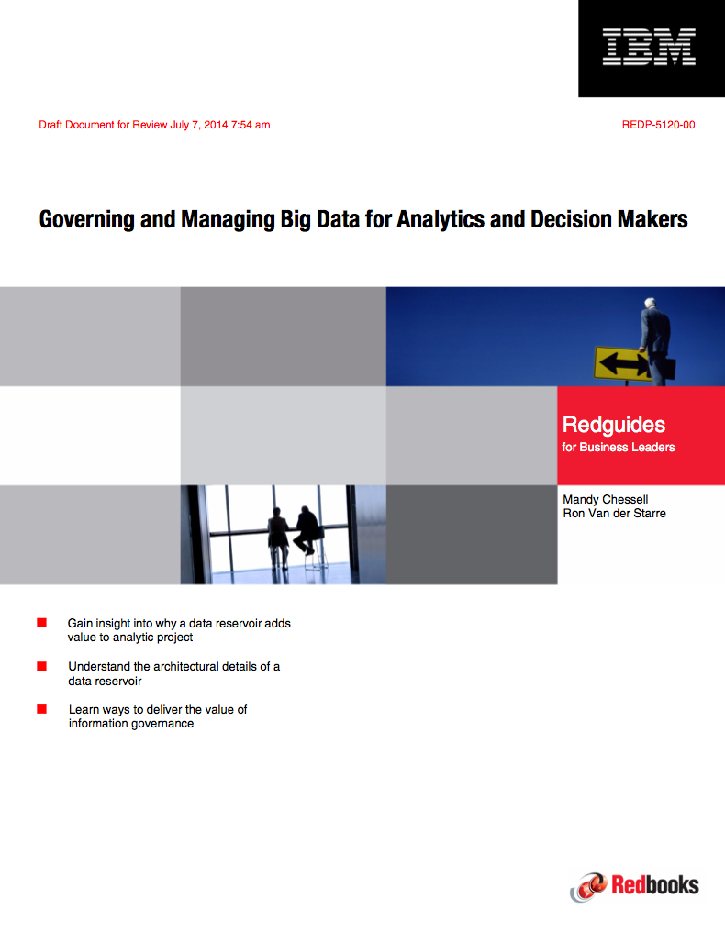
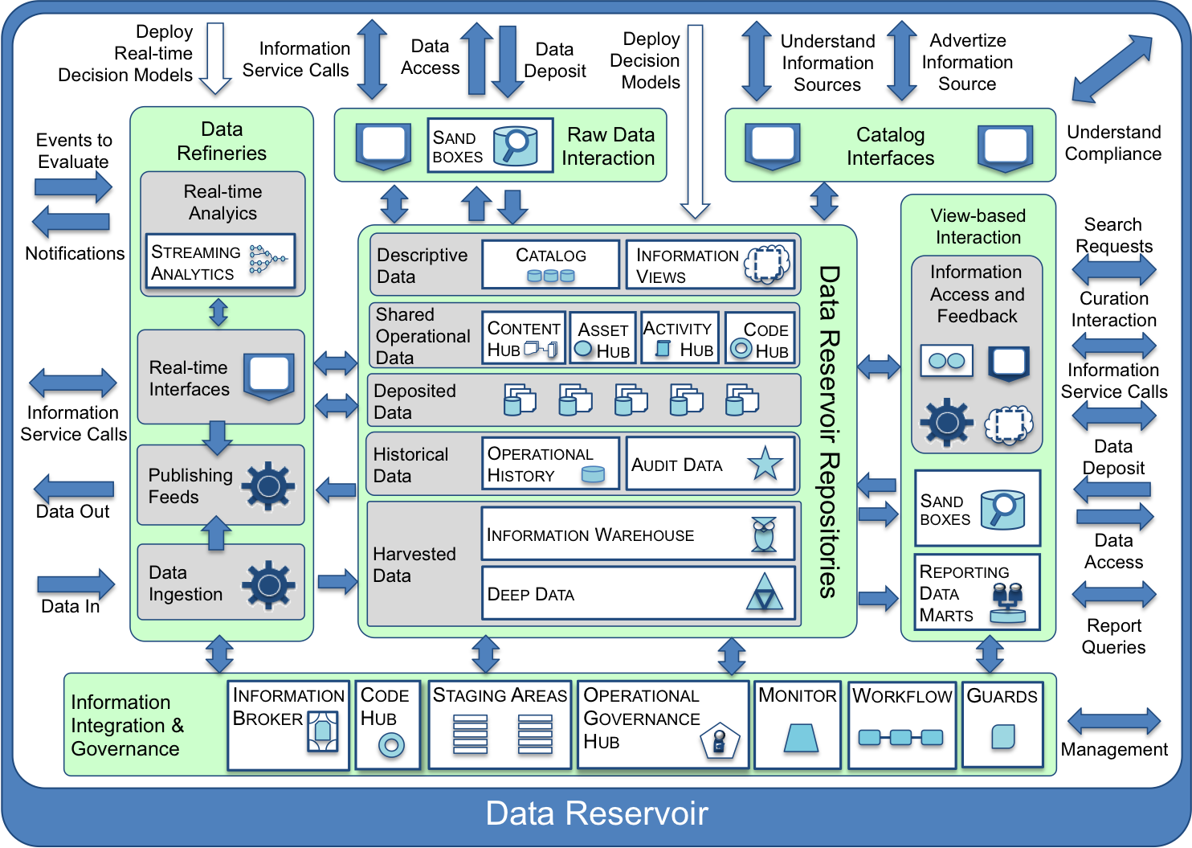
Governing and managing Big Data for Analytics and Decision Makers
An introduction to the Data Lake solution
http://www.redbooks.ibm.com/redpieces/abstracts/redp5120.html?Open

Slide 59
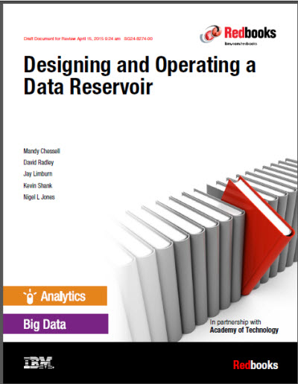
Designing and Operating a Data Reservoir
Description of the behaviour and processes that make up a data lake
Blog
  5 things to know about a data reservoir https://www.ibm.com/developerworks/community/blogs/5things/entry/5_things_to_know_about_data_reservoir?lang=en
Redbook
  http://www.redbooks.ibm.com/Redbooks.nsf/RedpieceAbstracts/sg248274.html?Open

Slide 60
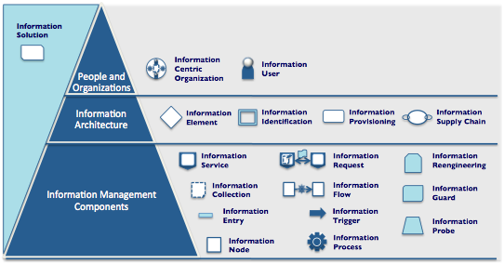
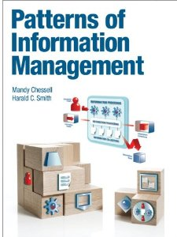
Patterns of Information Management
http://www.informit.com/store/patterns-of-information-management-9780133155501?WT.mc_id=Author_Chessell_PoIM
Vocabulary for design discussions.
Icons used in white-boarding and design documents.
Design guidance for specific solutions.
A catalogue of design choices.
Foundation for setting architecture standards and reference architectures.
Material for education and training in information architecture.
Notes:
The pattern names define a vocabulary to discuss issues and technology options related to information architecture, governance and management. The pattern names become the nouns and verbs of your design discussions, enabling you to characterize and choose between the options available.
The pattern icons can be used in white-boarding sessions and for documenting design decisions in reference architectures and solution specifications.
The pattern descriptions provide design guidance for specific information supply chains and solutions.
The pattern language provides a foundation for setting architectural standards and reference architectures. An organization can select the patterns they wish to support and develop reference implementations for them.
The pattern language provides material for education and training in information architecture.

Slide 61
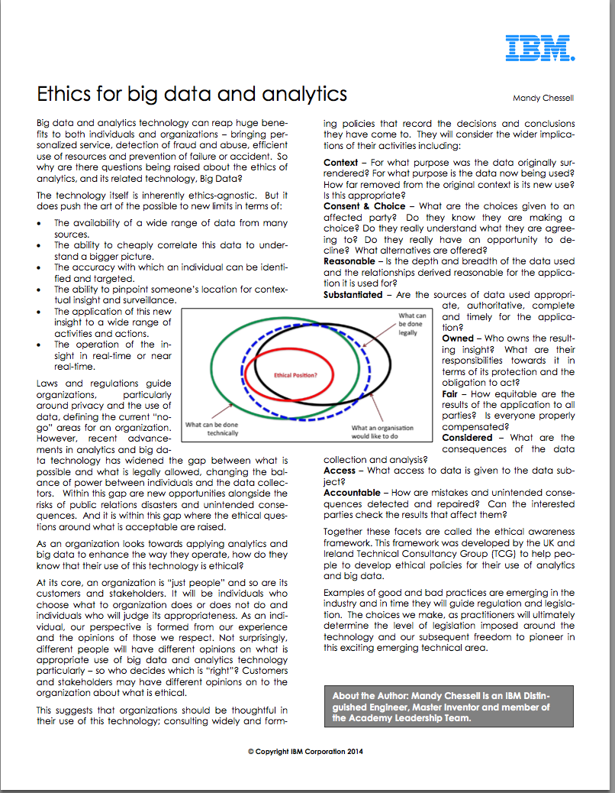
Ethics for Big Data and Analytics
Context – for what purpose was the data originally surrendered? For what purpose is the data now being used? How far removed from the original context is its new use?
Consent & Choice – What are the choices given to an affected party? Do they know they are making a choice? Do they really understand what they are agreeing to? Do they really have an opportunity to decline? What alternatives are offered?
Reasonable – is the depth and breadth of the data used and the relationships derived reasonable for the application it is used for?
Substantiated – Are the sources of data used appropriate, authoritative, complete and timely for the application?
Owned – Who owns the resulting insight? What are their responsibilities towards it in terms of its protection and the obligation to act?
Fair – How equitable are the results of the application to all parties? Is everyone properly compensated?
Considered – What are the consequences of the data collection and analysis?
Access – What access to data is given to the data subject?
Accountable – How are mistakes and unintended consequences detected and repaired? Can the interested parties check the results that affect them?
http://www.ibmbigdatahub.com/whitepaper/ethics-big-data-and-analytics

Slide 62
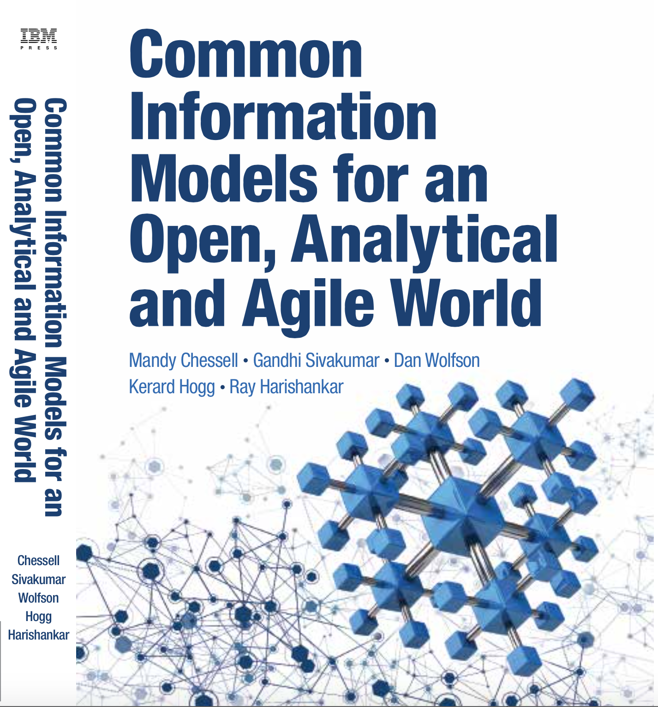
Common Information Models for an Open, Analytical and Agile World
To drive maximum value from complex IT projects, IT professionals need a deep understanding of the information their projects will use. Too often, however, IT treats information as an afterthought: the “poor stepchild” behind applications and infrastructure. That needs to change. This book will help you change it.
Using a complete case study, the authors explain what CIMs are, how to build them, and how to maintain them. You learn how to clarify the structure, meaning, and intent of any information you may exchange, and then use your CIM to improve integration, collaboration, and agility.
In today’s mobile, cloud, and analytics environments, your information is more valuable than ever. To build systems that make the most of it, start right here.

Slide 63
Links
Press Releases and Podcast
Open source repositories
  https://www.linuxfoundation.org/press-release/2018/08/odpi-announces-egeria-for-open-sharing-exchange-and-governance-of-metadata/
  https://www.linuxfoundation.org/press-release/2019/02/odpi-announces-new-egeria-conformance-program-to-advance-open-metadata-exchange-between-vendor-tools/
  https://roaringelephant.org/2018/09/25/episode-107-open-metadata-and-governance-masterclass-with-mandy-chessell-part-1/
  https://roaringelephant.org/2018/10/09/episode-109-open-metadata-and-governance-
  masterclass-with-mandy-chessell-part-2/
  https://youtu.be/ryd3KFWT1mc
  https://github.com/odpi/data-governance
  https://github.com/odpi/egeria
63

Slide 64
Open forum
z
z
z
z
z
z
z
Questions?

Slide 65
Key data lake use cases
Data Described
Data Added
Data Discovered
Data Located
Data Extracted
Data Accessed
Data Manipulated
Information
Curator
Information
User
Information
User
Information
User
Information
User
Information
User
Data
Scientist
Application
Advertise
Information
Source
Information
Service Calls
Data
Deposit
Understand
Information
Sources
Search
Requests
Data
Access
Information
Service Calls
Data
Access
Deploy
Decision
Models
Data flowing in /Published out
Catalog
Interfaces
Catalog
Interfaces
Sand
boxes
Data Repositories
Enterprise IT Interaction
Data Repositories
Data Repositories
Data Repositories
Data Repositories
Data Lake
Operations
Continuous
Analytics
Events to
Evaluate
Data Repositories
Streaming
Analytics
Event
Correlation
Repository
Data Repositories
Governance,
Risk and
Compliance Team
Notifications
Management
Enterprise IT
Service
Interfaces
Information
Service Calls
Repository
Information
Broker
Understand
Compliance
Data Repositories
Publishing
Feeds
Data Out
Catalog
Interfaces
Data Processing within the data lake
Automated maintenance
Governance assessment and planning
Infrastructure and software maintenance
Data In
Data
Ingestion

